Slide 1

50.039 Theory and Practice of Deep Learning W11S2 Introduction to Reinforcement Learning
Matthieu De Mari

Slide 2
About this week
What is Reinforcement Learning?
What are the key ideas behind reinforcement learning and its framework?
What is the exploration vs. exploitation tradeoff?
How do we train an RL agent by exploring, then progressively exploiting?
What are some advanced strategies in multi-arm bandit problems?
What are the Q and V functions for a RL problem?
What is Q-learning and how can it be implemented in RL problems?

Slide 3
About this week
What is Deep Q Learning? And which problem does it address?
What is RL with Human Feedback?
How to implement RLHF via the REINFORCE algorithm?
What are actor-critic learning methods? And which problems do these approaches address?
What are more advanced problems in RL?
Markov states
Partially observable environment
SARSA
Non-stationary problems

Slide 4
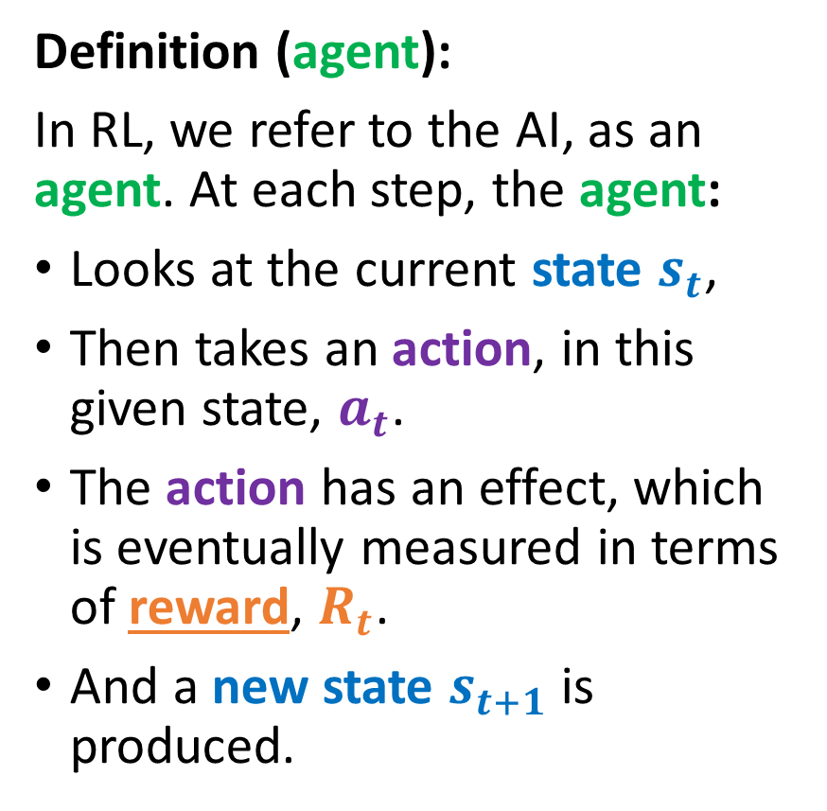
Reusing the RL formalism
Definition (agent):
In RL, we refer to the AI, as an agent. At each step, the agent:
Looks at the current state $s_{t}$,
Then takes an action, in this given state, $a_{t}$.
The action has an effect, which is eventually measured in terms of reward, $R_{t}$.
And a new state $s_{t+1}$ is produced.
State $s_{t}$
State 𝒔_𝒕
Take action based on state $a_{t}$
Take action based on state 𝒂_𝒕
Reward $R_{t}\left(a_{t}, s_{t}\right)$ is given for taking action in said state
Reward 𝑹_𝒕 (𝒂_𝒕, 𝒔_𝒕 ) is given for taking action in said state
Environment changes and a new state $s_{t+1}$ is produced
Environment changes and a new state 𝒔_(𝒕+𝟏) is produced

Slide 5
Exploration and exploitation tradeoff
Definition (exploration and exploitation):
The phase during which, you try out things to acquire knowledge about the problem is called exploration.
The second phase, where you rely on your acquired knowledge, and play what you feel is the best move, is called exploitation.
Definition (exploration vs. exploitation tradeoff):
A good RL-based AI, needs to smartly combine exploration and exploitation phases.
Too much exploration? You have wasted coins trying out bad machines.
No enough exploration? You might end up choosing the wrong machine as the “best” one.

Slide 6
A second toy problem
The Maze problem

Slide 7
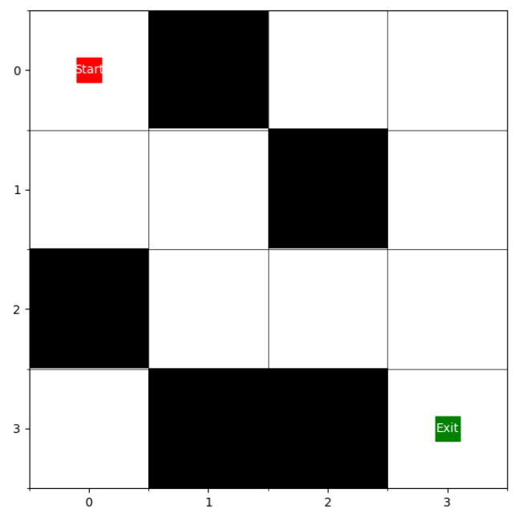
The maze problem
Let us consider the maze problem, described on the right.
The objective is
to find the shortest path between the start and goal squares,
without any knowledge of what the maze is beforehand.

Slide 8
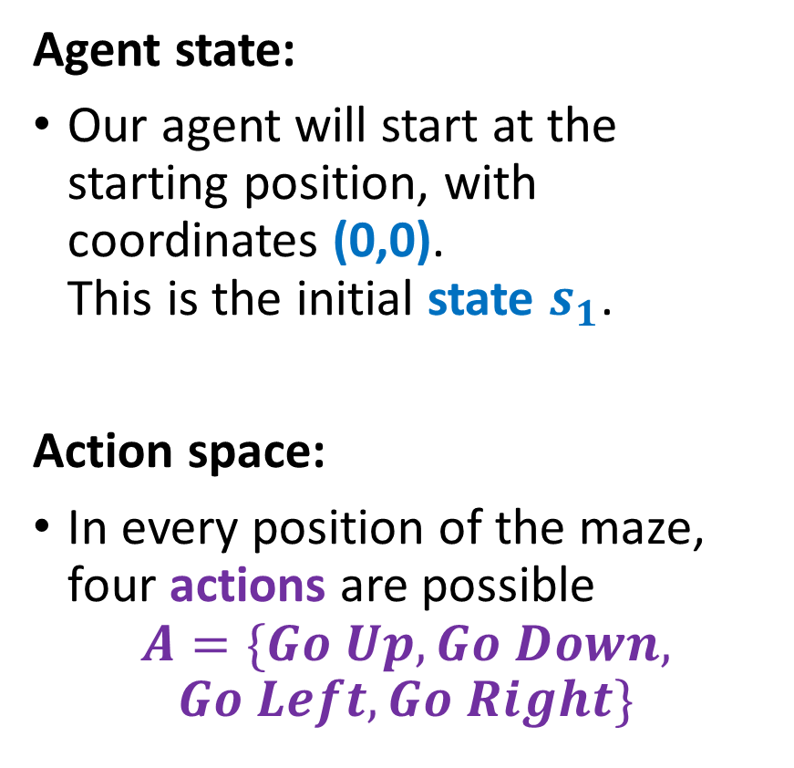
The maze problem
Agent state:
Our agent will start at the starting position, with coordinates (0,0). This is the initial state $s_{1}$.
Action space:
In every position of the maze, four actions are possible
$$A=\{Go Up, Go Down,$$
$$Go Left,Go Right\}$$

Slide 9
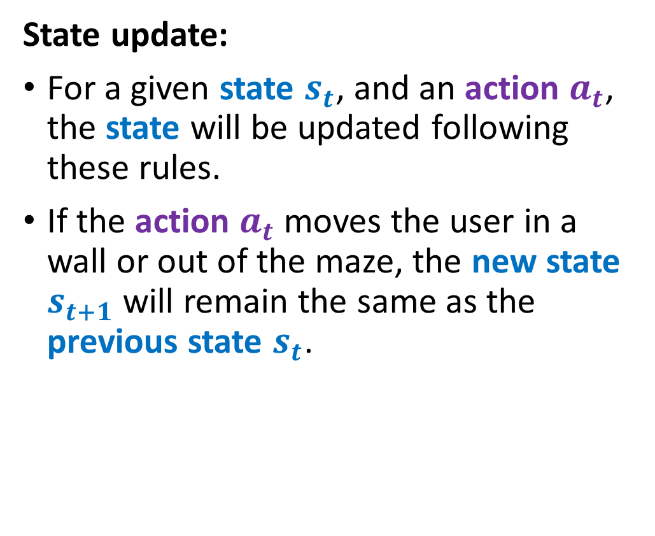
The maze problem
State update:
For a given state $s_{t}$, and an action $a_{t}$, the state will be updated following these rules.
If the action $a_{t}$ moves the user in a wall or out of the maze, the new state $s_{t+1}$ will remain the same as the previous state $s_{t}$.

Slide 10
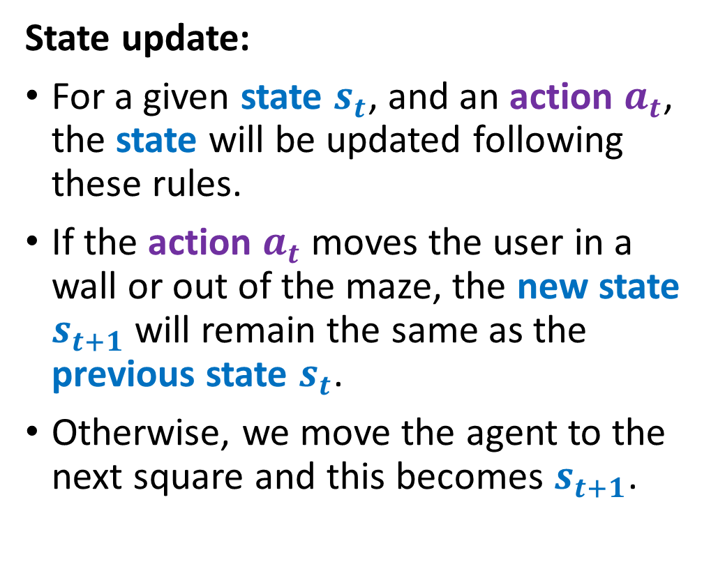
The maze problem
State update:
For a given state $s_{t}$, and an action $a_{t}$, the state will be updated following these rules.
If the action $a_{t}$ moves the user in a wall or out of the maze, the new state $s_{t+1}$ will remain the same as the previous state $s_{t}$.
Otherwise, we move the agent to the next square and this becomes $s_{t+1}$.
$$s_{t}=\left(0,0\right)+a_{t}=Down→s_{t+1}=(0,1)$$

Slide 11
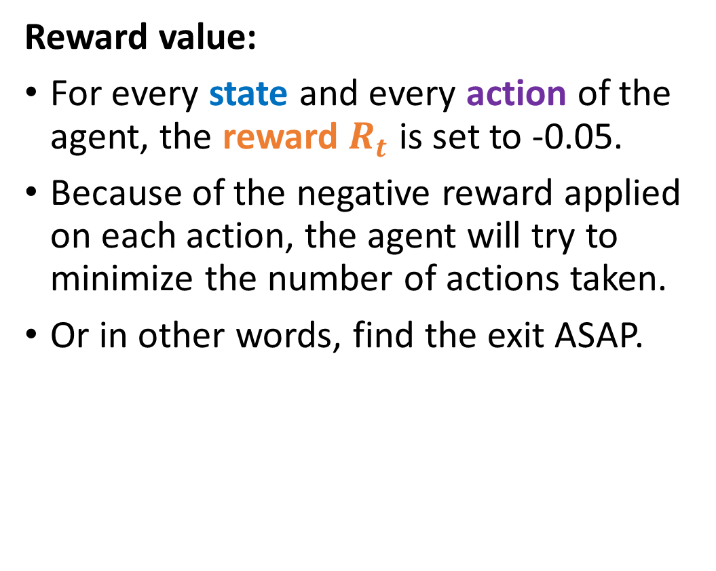
The maze problem
Reward value:
For every state and every action of the agent, the reward $R_{t}$ is set to -0.05.
Because of the negative reward applied on each action, the agent will try to minimize the number of actions taken.
Or in other words, find the exit ASAP.

Slide 12
The maze problem
Reward value:
In addition, the agent will be penalized by -0.75 if the action taken makes it bump into a wall.
It will receive a negative penalty -0.25 if it revisits a cell it has already seen (i.e. comes back to a previously visited cell).
These strong negative penalties will further encourage the agent to try to minimize the number of actions taken.

Slide 13
The maze problem
Reward value:
The game stops if the agent reaches the exit, that is state (3,3). In this scenario, a large positive reward of +10 is given to encourage the agent to reach the exit.
The game will also stop if the cumulated reward falls below a certain quantity (e.g. -10) to prevent the agent from aimlessly roaming in the maze for too long.

Slide 14
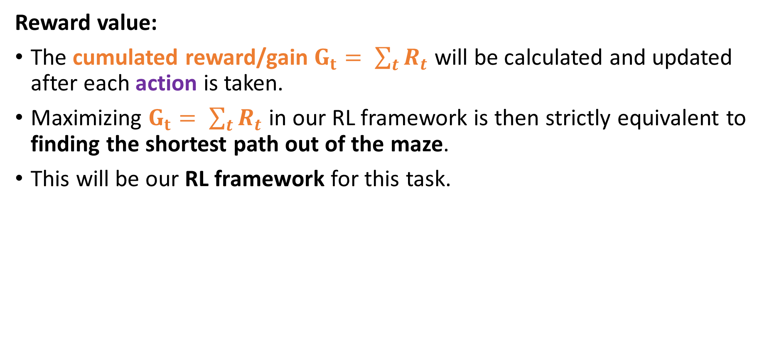
The maze problem
Reward value:
The cumulated reward/gain $G_{t}= \sum_{t}{R_{t}}$ will be calculated and updated after each action is taken.
Maximizing $G_{t}= \sum_{t}{R_{t}}$ in our RL framework is then strictly equivalent to finding the shortest path out of the maze.
This will be our RL framework for this task.

Slide 15
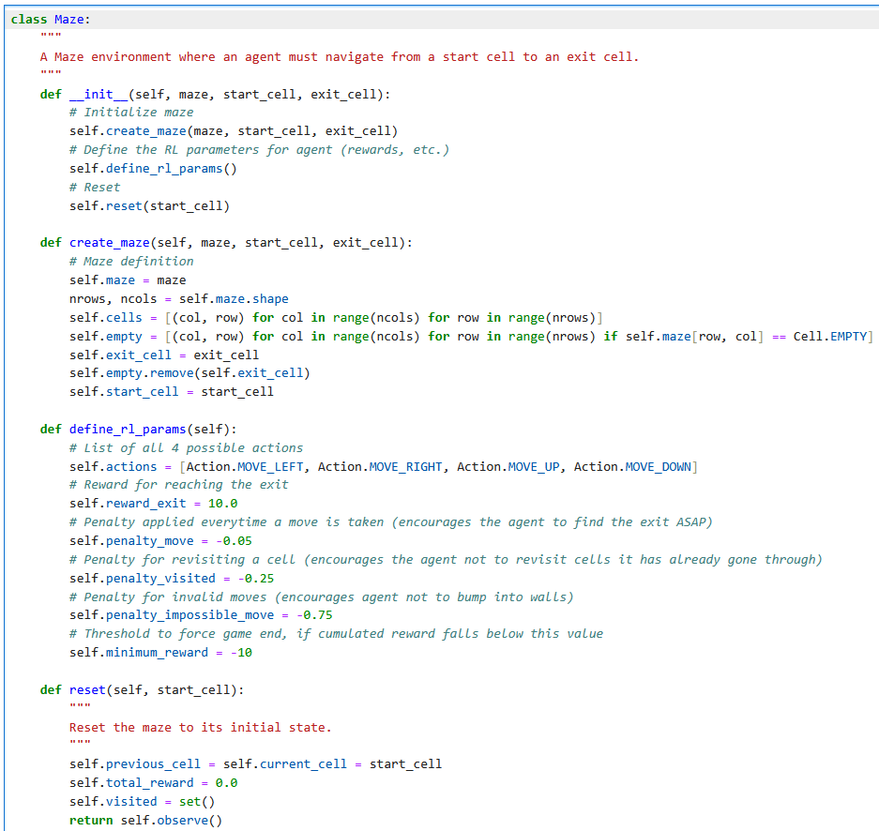
The Maze environment
Notebook 4 shows the implementation of the environment.
Self-study the code and focus on the environment attributes and methods.

Slide 16
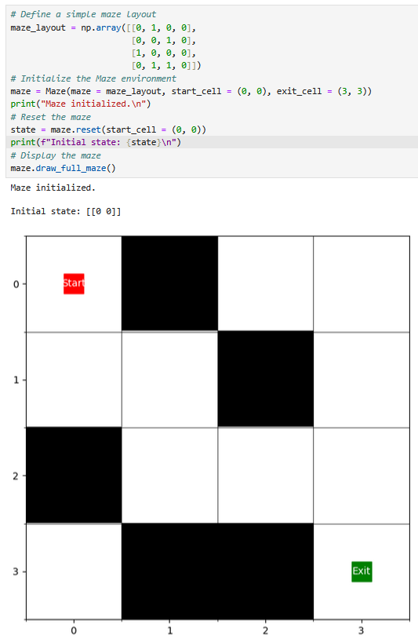
The Maze environment
Notebook 4 shows the implementation of the environment.
Self-study the code and focus on the environment attributes and methods.

Slide 17
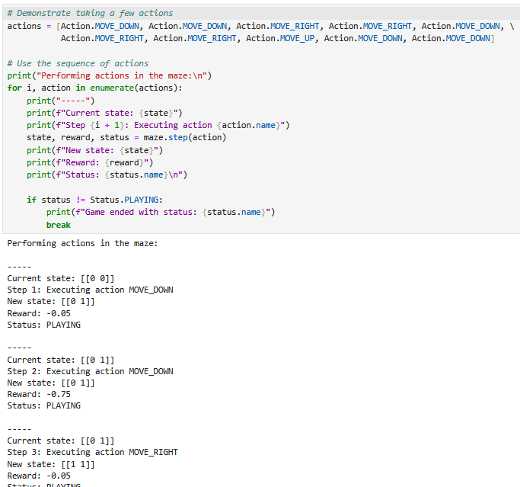
The Maze environment
Notebook 4 shows the implementation of the environment.
Self-study the code and focus on the environment attributes and methods.
Pay special attention to the agent action methods (possible actions, observe, execute, visited, etc.)

Slide 18
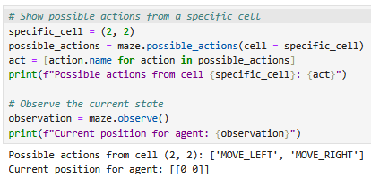
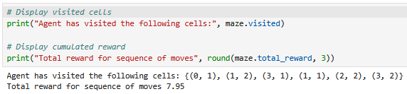
The Maze environment
Notebook 4 shows the implementation of the environment.
Self-study the code and focus on the environment attributes and methods.
Pay special attention to the agent action methods (possible actions, observe, execute, visited, etc.)

Slide 19
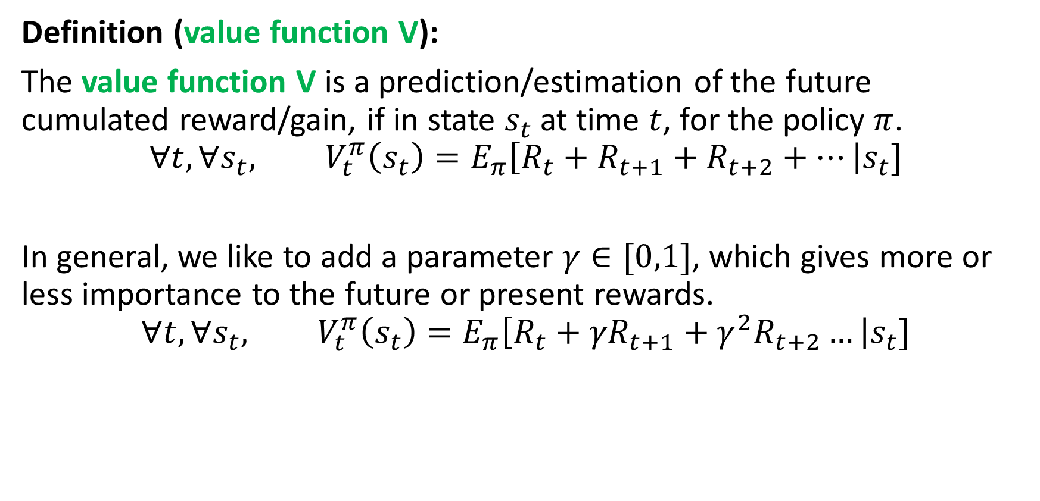
Value function V
Definition (value function V):
The value function V is a prediction/estimation of the future cumulated reward/gain, if in state $s_{t}$at time $t$, for the policy $π$.
$$∀t,∀s_{t}, V_{t}^{π}\left(s_{t}\right)=E_{π}\left[R_{t}+R_{t+1}+R_{t+2}+…\right|s_{t}]$$
In general, we like to add a parameter $γ∈[0,1]$, which gives more or less importance to the future or present rewards.
$$∀t,∀s_{t}, V_{t}^{π}\left(s_{t}\right)=E_{π}\left[R_{t}+{γR}_{t+1}+γ^{2}R_{t+2}…\right|s_{t}]$$

Slide 20
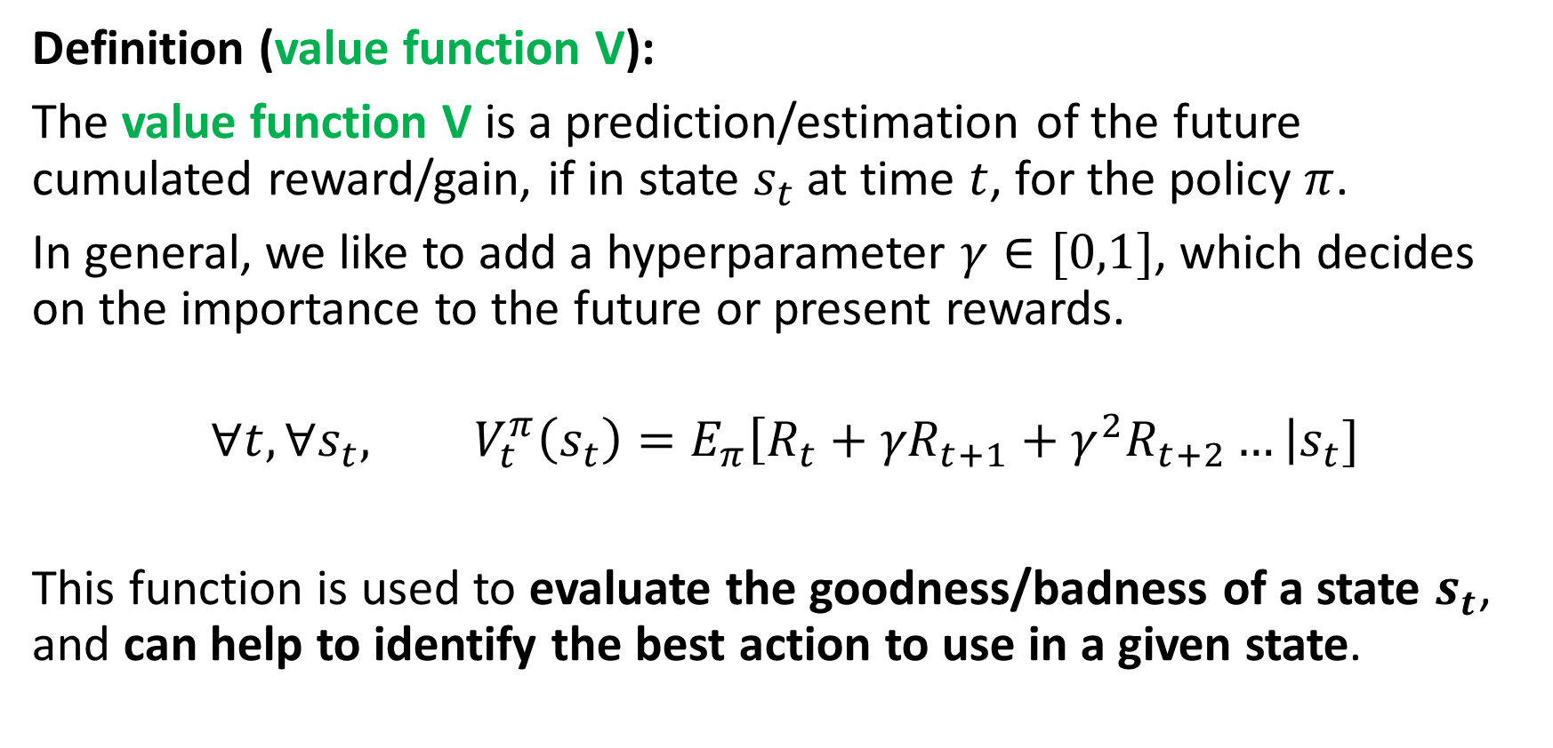
Value function V
Definition (value function V):
The value function V is a prediction/estimation of the future cumulated reward/gain, if in state $s_{t}$at time $t$, for the policy $π$.
In general, we like to add a hyperparameter $γ∈[0,1]$, which decides on the importance to the future or present rewards.
$$∀t,∀s_{t}, V_{t}^{π}\left(s_{t}\right)=E_{π}\left[R_{t}+{γR}_{t+1}+γ^{2}R_{t+2}…\right|s_{t}]$$
This function is used to evaluate the goodness/badness of a state $s_{t}$, and can help to identify the best action to use in a given state.

Slide 21
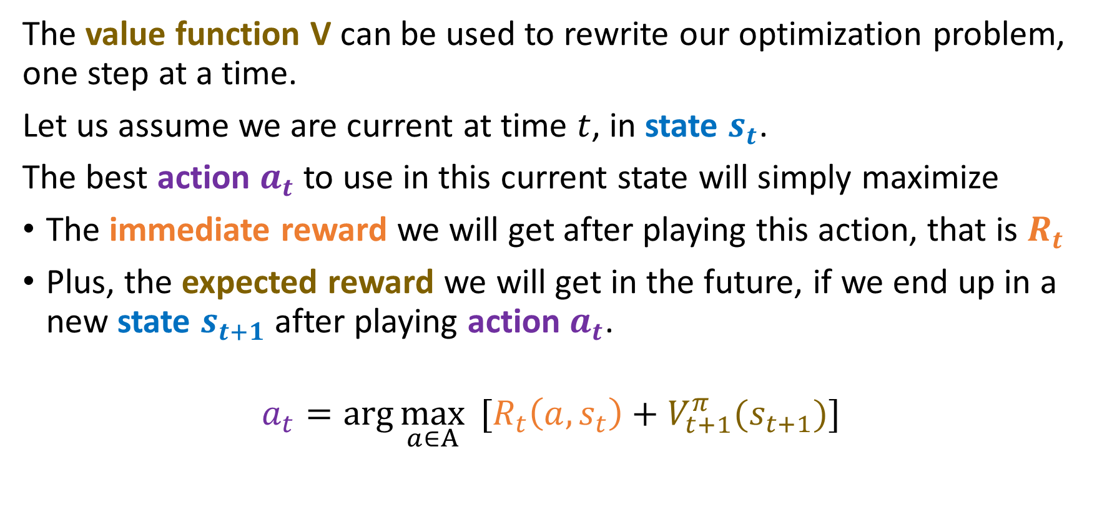
Optimization with value function V
The value function V can be used to rewrite our optimization problem, one step at a time.
Let us assume we are current at time $t$, in state $s_{t}$.
The best action $a_{t}$ to use in this current state will simply maximize
The immediate reward we will get after playing this action, that is $R_{t}$
Plus, the expected reward we will get in the future, if we end up in a new state $s_{t+1}$after playing action $a_{t}$.
$$a_{t}=\arg{\max_{a∈A}{ [R_{t}\left(a,s_{t}\right)+V_{t+1}^{π}(s_{t+1})]}}$$

Slide 22
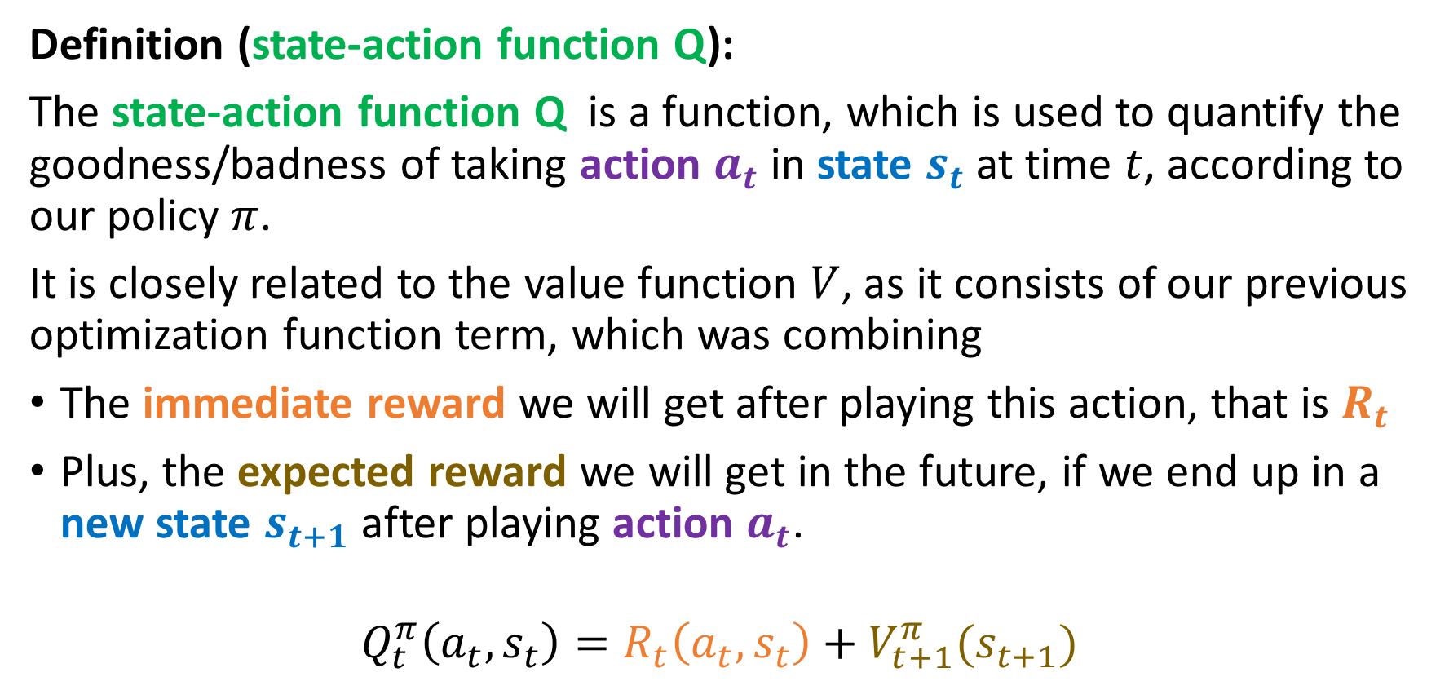
The state-action function Q
Definition (state-action function Q):
The state-action function Q is a function, which is used to quantify the goodness/badness of taking action $a_{t}$ in state $s_{t}$at time $t$, according to our policy $π$.
It is closely related to the value function $V$, as it consists of our previous optimization function term, which was combining
The immediate reward we will get after playing this action, that is $R_{t}$
Plus, the expected reward we will get in the future, if we end up in a new state $s_{t+1}$after playing action $a_{t}$.
$$Q_{t}^{π}\left(a_{t},s_{t}\right)=R_{t}\left(a_{t},s_{t}\right)+V_{t+1}^{π}(s_{t+1})$$

Slide 23
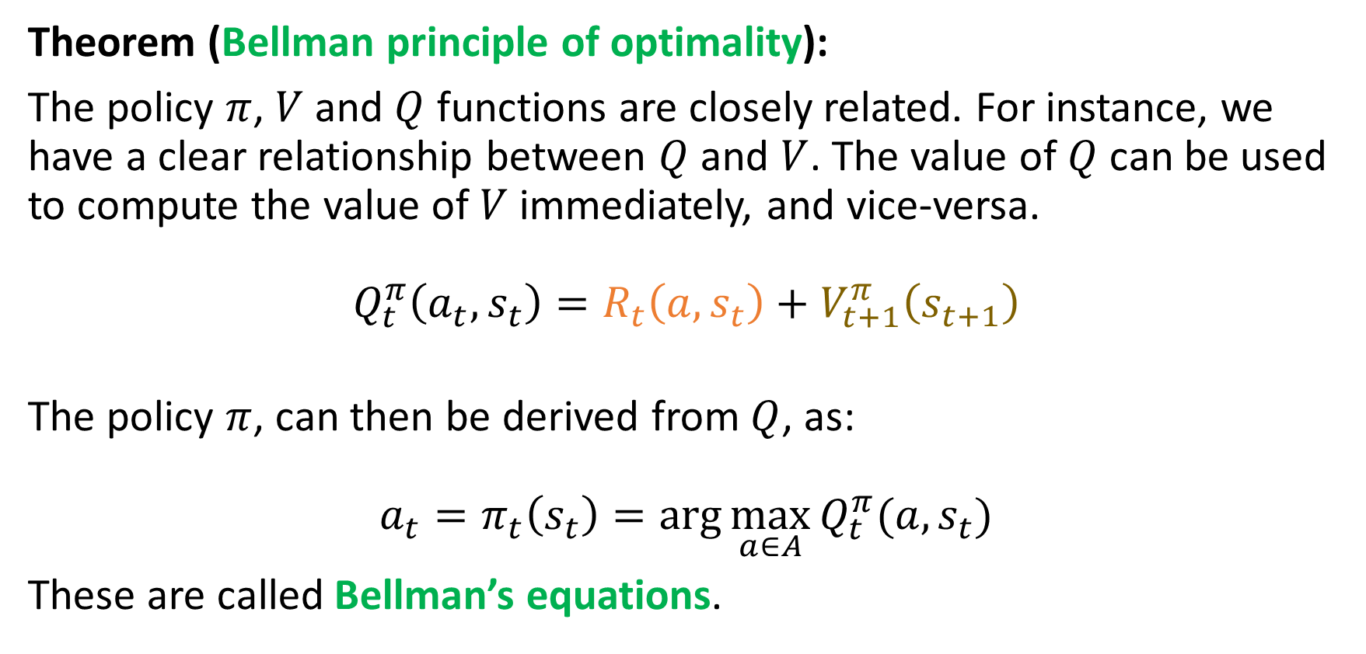
On the policy, V and Q functions relationship
Theorem (Bellman principle of optimality):
The policy $π$, $V$ and $Q$ functions are closely related. For instance, we have a clear relationship between $Q$ and $V$. The value of$Q$can be used to compute the value of $V$ immediately, and vice-versa.
$$Q_{t}^{π}\left(a_{t},s_{t}\right)=R_{t}\left(a,s_{t}\right)+V_{t+1}^{π}\left(s_{t+1}\right)$$
The policy $π$, can then be derived from $Q$, as:
$$a_{t}=π_{t}\left(s_{t}\right)=\arg{\max_{a∈A}{Q_{t}^{π}(a, s_{t})}}$$
These are called Bellman’s equations.

Slide 24
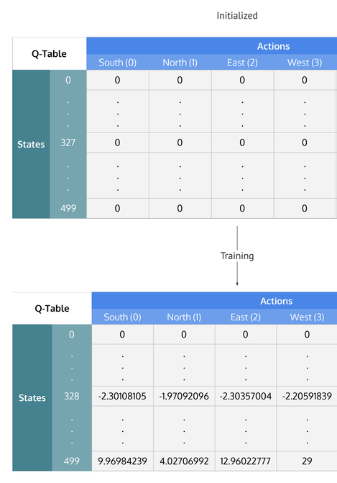
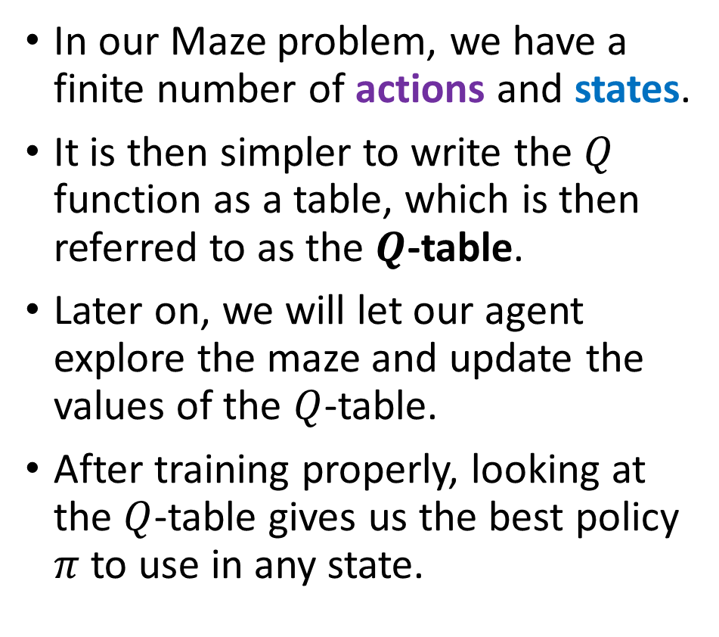
Defining a Q-table
In our Maze problem, we have a finite number of actions and states.
It is then simpler to write the $Q$ function as a table, which is then referred to as the $Q$-table.
Later on, we will let our agent explore the maze and update the values of the $Q$-table.
After training properly, looking at the $Q$-table gives us the best policy $π$to use in any state.

Slide 25
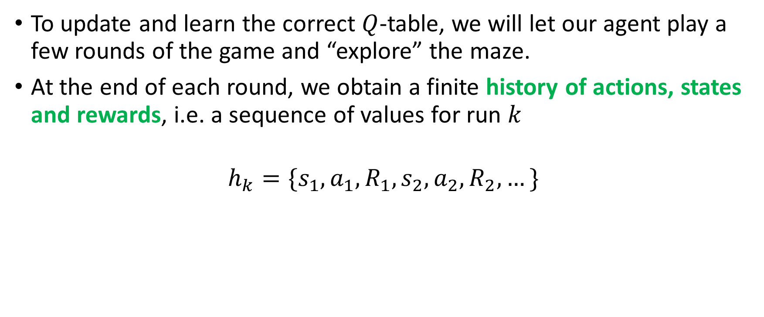
Updating the Q-table via Q-learning
To update and learn the correct $Q$-table, we will let our agent play a few rounds of the game and “explore” the maze.
At the end of each round, we obtain a finite history of actions, states and rewards, i.e. a sequence of values for run $k$
$$h_{k}=\{s_{1},a_{1},R_{1},s_{2},a_{2},R_{2},…\}$$

Slide 26
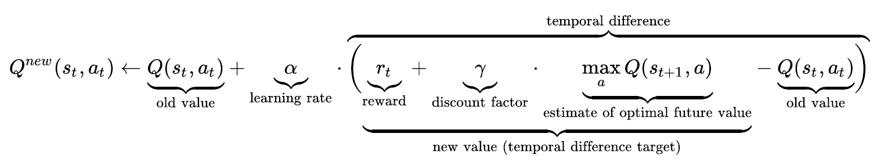
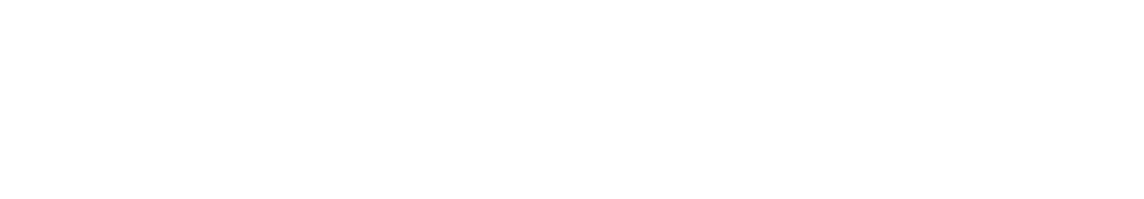
Updating the Q-table via Q-learning
This sequence can then be used, to update the Q-table, according to
In a sense, this formula is the “equivalent” of our gradient descent update, but in the case of reinforcement learning, and is commonly referred to as Q-learning.

Slide 27

A bit of a mathematical explanation
$Q(s_{t},a_{t})$ (Old Value): This is the current estimate of the Q-value for the state-action pair $(s_{t}, a_{t})$ according to our current understanding of the game that is stored in the Q-table.
$r_{t}$: The immediate reward received after taking action $a_{t}$​ in state $s_{t}$​.

Slide 28

A bit of a mathematical explanation
$γ\max_{a}{Q(s_{t+1},a)}$ (Estimate of Optimal Future Value): This term estimates the best possible discounted future reward assuming the best action is taken at the next state $s_{t+1}$​.

Slide 29

A bit of a mathematical explanation
$r_{t}+γ \max_{a}⁡Q(s_{t+1},a)$ (Temporal Difference Target): This is the target for updating the Q-value. It consists of the immediate reward and the best possible future return.

Slide 30

A bit of a mathematical explanation
$r_{t}+γ\max_{a}{Q\left(s_{t+1},a\right)}−Q\left(s_{t},a\right)$(Temporal Difference Error): The difference between the estimated Q-value and the observed reward-based estimate (called TD error). If this difference is large, the update will be significant.

Slide 31

A bit of a mathematical explanation
The learning rate $α$ determines to what extent newly acquired information overrides old information in the $Q$-table.
A value 0 makes the agent learn nothing (exclusively exploiting prior knowledge), while a factor of 1 makes the agent consider only the most recent information (ignoring prior knowledge to explore possibilities). Use something in-between!

Slide 32

A bit of a mathematical explanation
The discount factor $γ$ determines the importance of future rewards.
A value 0 will make the agent "myopic" (or short-sighted) by only considering current rewards, i.e. $R_{t}$ (in the update rule above).
A value approaching 1 will make it strive for a long-term high reward.

Slide 33

Updating the Q table via exploration
This Q-learning update formula will eventually update the Q-values and makes them converge to their “real” values.
It also implicitly assumes some initial values in the $Q$-table before the first update occurs. High initial values, also known as "optimistic initial conditions“ tend to encourage exploration, helping the agent learn through trial and error of actions it has never used before in all states.

Slide 34
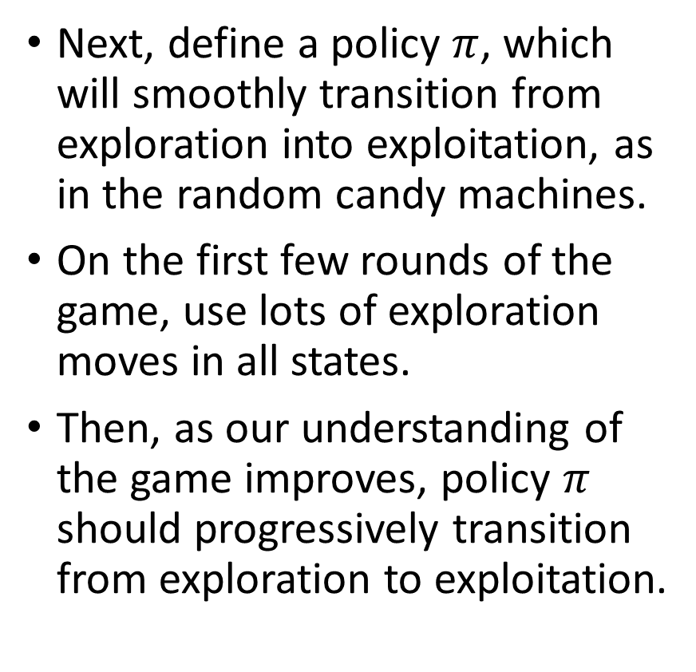
Training an agent
Next, define a policy $π$, which will smoothly transition from exploration into exploitation, as in the random candy machines.
On the first few rounds of the game, use lots of exploration moves in all states.
Then, as our understanding of the game improves, policy $π$ should progressively transition from exploration to exploitation.

Slide 35
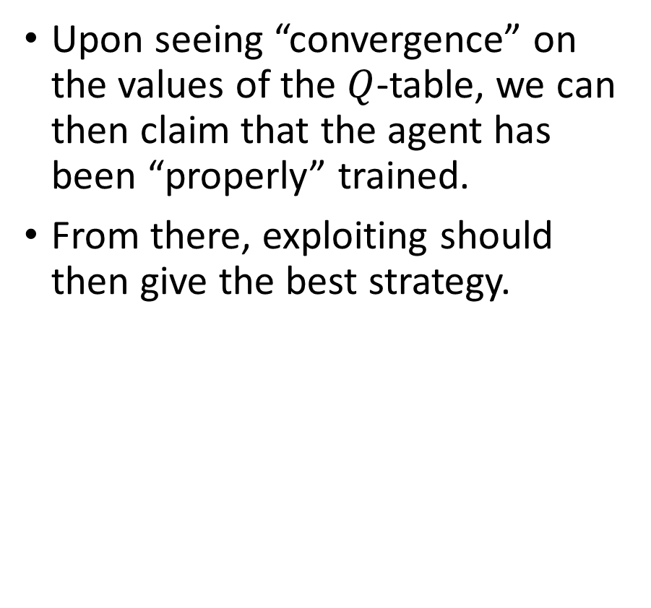
Training an agent
Upon seeing “convergence” on the values of the $Q$-table, we can then claim that the agent has been “properly” trained.
From there, exploiting should then give the best strategy.

Slide 36
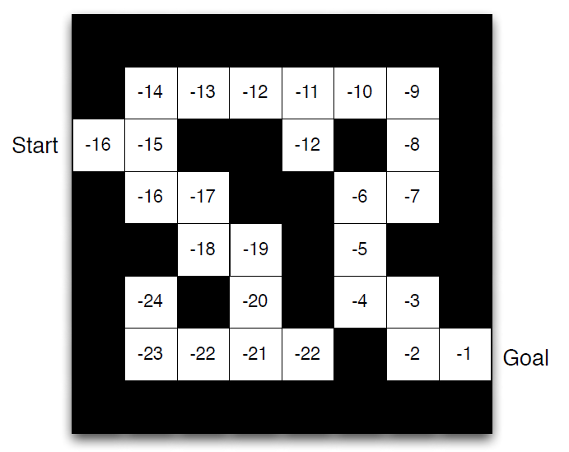
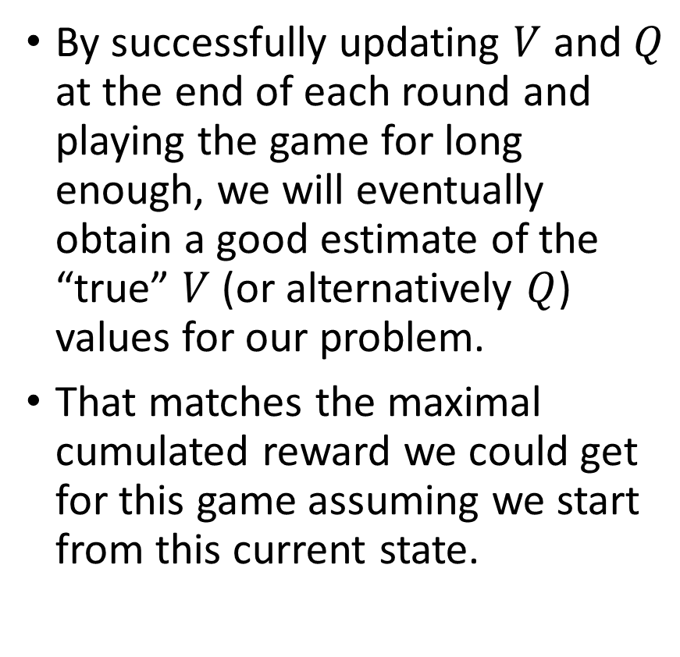
Training an agent
By successfully updating $V$ and $Q$ at the end of each round and playing the game for long enough, we will eventually obtain a good estimate of the “true” $V$ (or alternatively $Q$) values for our problem.
That matches the maximal cumulated reward we could get for this game assuming we start from this current state.
Note: the values above are arbitrary and used for illustrative purposes only, in practice they might be something else.

Slide 37
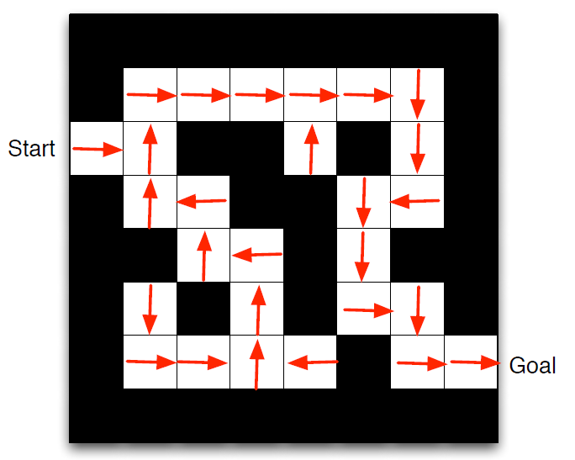
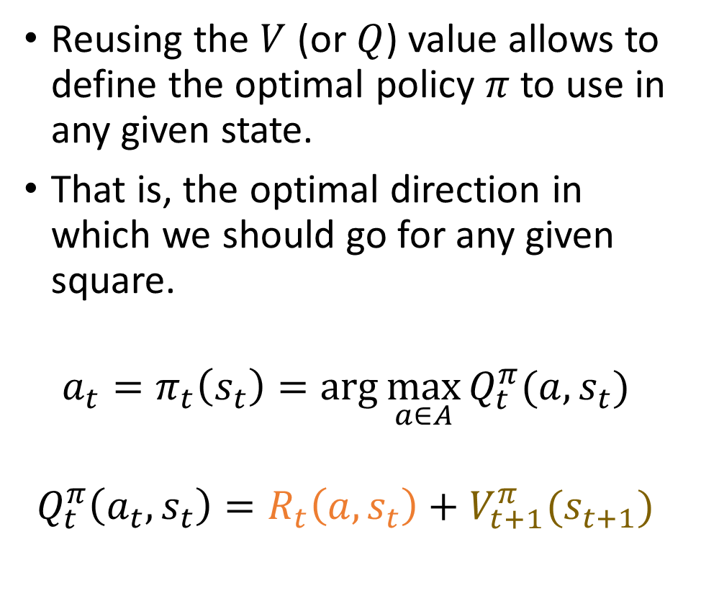
Training an agent
Reusing the $V$ (or $Q$) value allows to define the optimal policy $π$ to use in any given state.
That is, the optimal direction in which we should go for any given square.
$$a_{t}=π_{t}\left(s_{t}\right)=\arg{\max_{a∈A}{Q_{t}^{π}(a, s_{t})}}$$
$$Q_{t}^{π}\left(a_{t},s_{t}\right)=R_{t}\left(a,s_{t}\right)+V_{t+1}^{π}(s_{t+1})$$

Slide 38
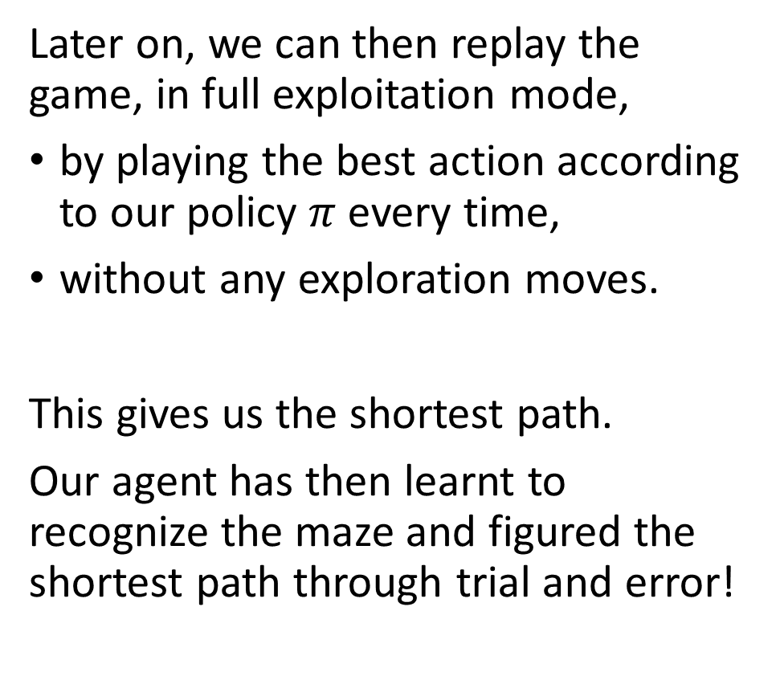
Training an agent
Later on, we can then replay the game, in full exploitation mode,
by playing the best action according to our policy $π$every time,
without any exploration moves.
This gives us the shortest path.
Our agent has then learnt to recognize the maze and figured the shortest path through trial and error!

Slide 39
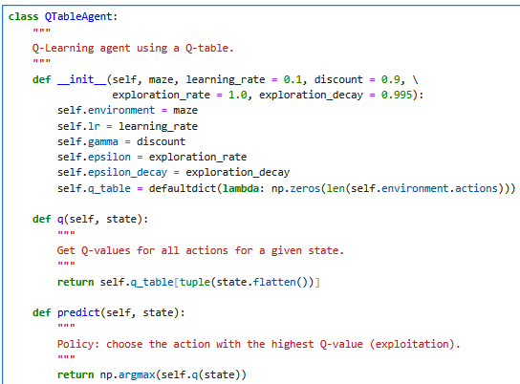
Implementing a Q-table agent
Our QTableAgent class represents an AI agent that:
Explores and exploits the environment.
Uses a Q-table to store Q-values.
Trains the Q-table using our Q-learning formula to learn the optimal Q-values and use them to find the optimal moves.
Improves over time by balancing exploration and exploitation, with exploration decay.

Slide 40
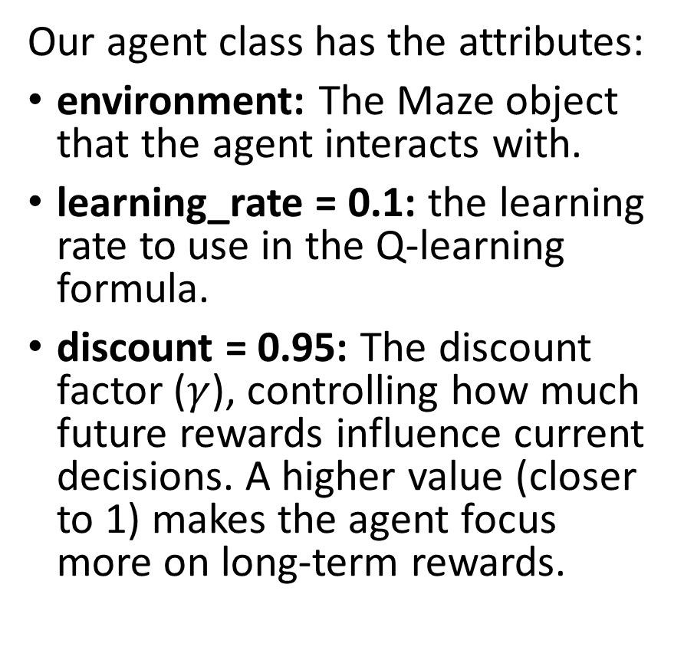
Implementing a Q-table agent
Our agent class has the attributes:
environment: The Maze object that the agent interacts with.
learning_rate = 0.1: the learning rate to use in the Q-learning formula.
discount = 0.95: The discount factor ($γ$), controlling how much future rewards influence current decisions. A higher value (closer to 1) makes the agent focus more on long-term rewards.

Slide 41
Implementing a Q-table agent
exploration_rate = 1.0: The initial probability of taking random actions instead. Here, 1.0 means full exploration at the start.
exploration_decay = 0.995: The rate at which exploration decreases over time. This ensures that the agent starts by exploring but gradually shifts to exploitation (following learned policies), by progressively shifting from 1 to 0 over the different episodes.

Slide 42
Implementing a Q-table agent
Our agent has the following methods:
q(): Returns the Q-values for all possible actions in a given state. Uses the trained Q-table without modifying it.
predict(): Uses the Q-table to predict the best-known action (highest Q-value) in a given state.

Slide 43
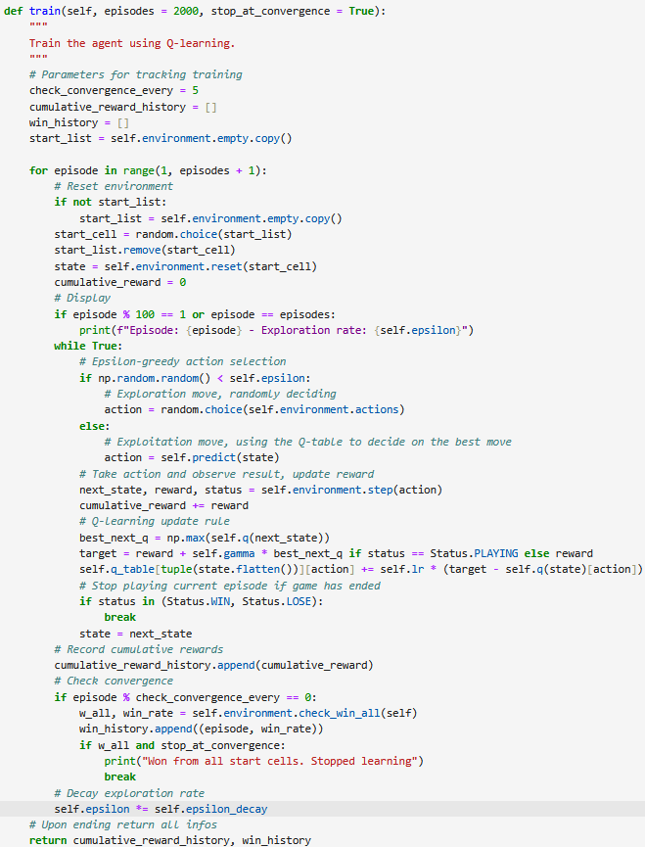
Trainer function
In the train() method, the training process consists of looping through multiple episodes, and on each episode, the game unfolds by following these steps:
First, we start from a random valid position in the maze, not necessarily the start position (0, 0).
In each state, we select actions using ε-greedy strategy. If an exploration move is selected, use a random action. If an exploitation move is selected, use the predict method to choose the best move to use given our current understanding of the game.
After a move is selected, the environment changes.

Slide 44
Trainer function
After, we update Q-values using our Q-learning formula.
While looping through multiple episodes, we track cumulative rewards and win rate over time.
We also perform a decay on the exploration rate to progressively shift from exploring to exploiting.

Slide 45
Trainer function
The training loops runs for a given number of episodes.
Game stops upon reaching the exit, or the lowest penalty acceptable (timing out after too many moves taken)
Training might stop early if the agent is able to win from all cells (early stopping?)

Slide 46
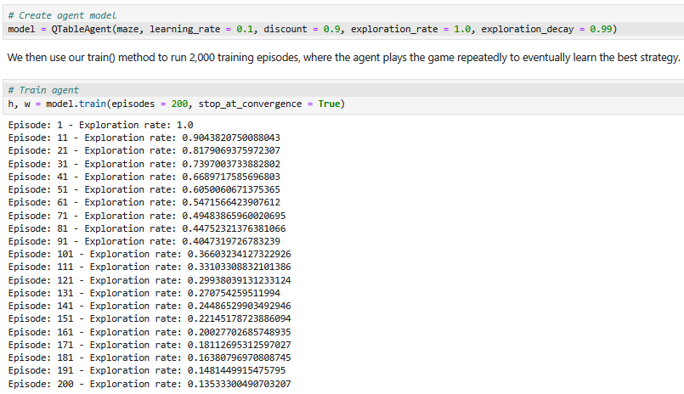
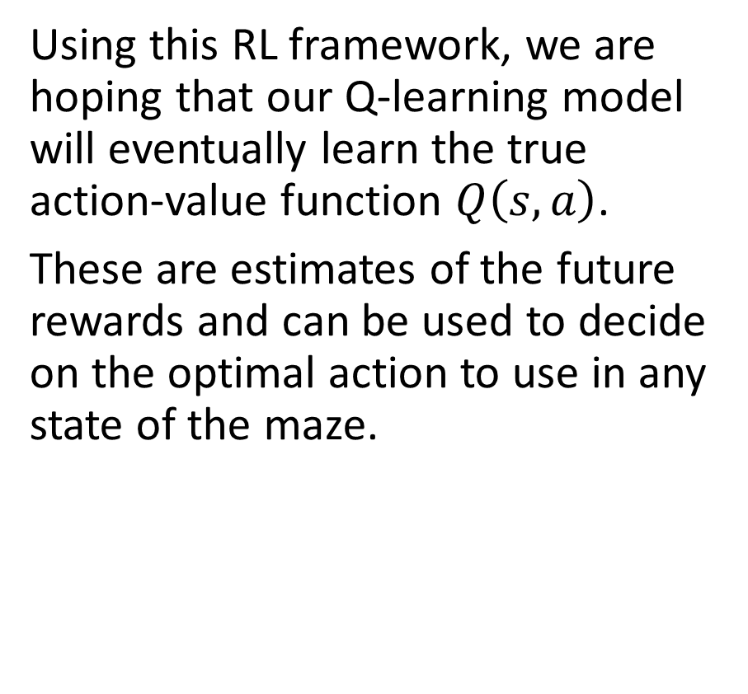
Trainer function
Using this RL framework, we are hoping that our Q-learning model will eventually learn the true action-value function $Q\left(s, a\right)$.
These are estimates of the future rewards and can be used to decide on the optimal action to use in any state of the maze.

Slide 47
Trainer function
Upon running the train() method:
Notice how the exploration rate progressively shifts from 1 to 0.

Slide 48
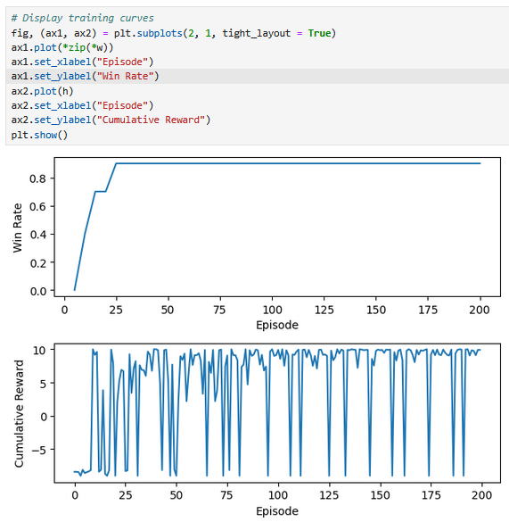
Trainer function
Upon running the train() method:
Notice how the exploration rate progressively shifts from 1 to 0.
Notice also how the average rewards are increasing (indicating that the agent is learning to improve at playing the game).
Our win rate is also increasing and eventually plateauing at almost 100%.

Slide 49
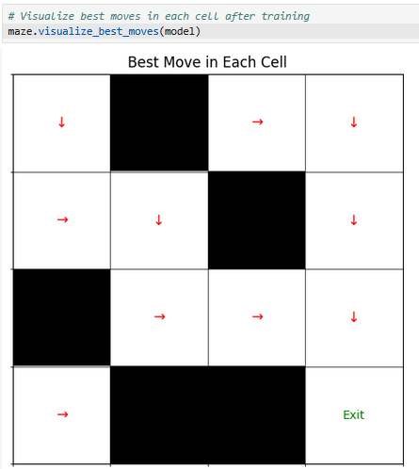
Trainer function
Finally, we can visualize the entire maze and the best move to use in each walkable cell.
When starting in cell (0, 0), the agent is clearly able to identify the shortest path to exit the maze without hitting any walls!

Slide 50
Trainer function
There are however cells that are still problematic... For instance, cell (0, 3) suggests to go left, which is wrong…
But not the end of the world given that this cell is impossible to reach from (0, 0).

Slide 51
Trainer function
While this suggests that the Q-Learning agent has yet more to learn about the maze and the best moves to use, this agent is, however, capable of learning the shortest path in a maze!
This Q-learning approach can be used in any RL problem with a finite number of states, a finite number of actions and a clearly established reward system.

Slide 52
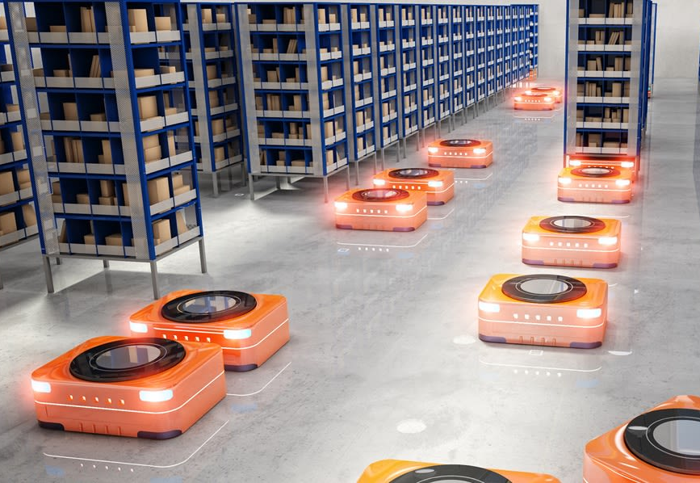
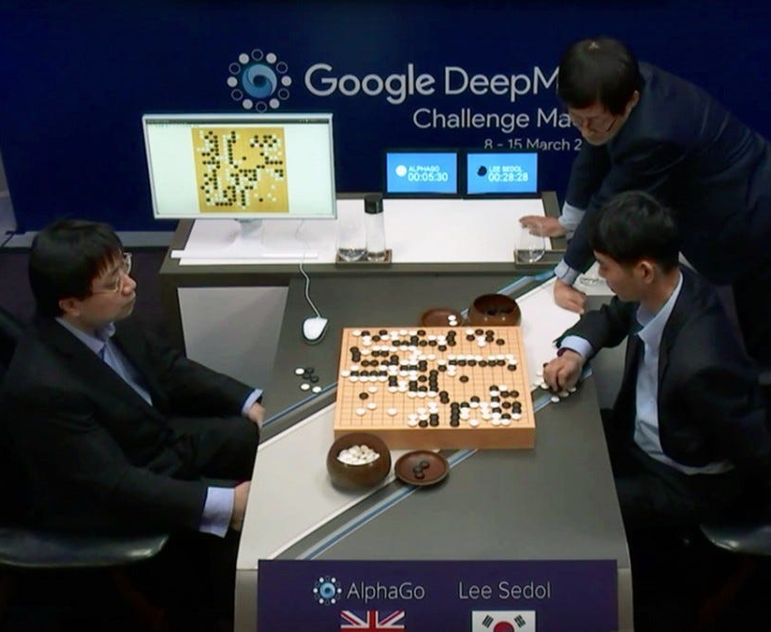
Possible Applications of Q-learning
Q-tables and Q-learning can be used if the RL framework has a finite number of states and actions.
Warehouse robotics navigation, using tiles drawn on the floor.
Simple board games (maybe Go should not be considered a “simple” board game?)
Quiz-based learning agents
States: Learner’s knowledge level (discretized).
Actions: Select next question or hint.
Goal: Maximize engagement and learning.

Slide 53
Limitations of Q-learning
Open question: What if the number of states and/or the number of actions is not finite?
We would not be able to use a Q-table to store values…
→ Idea: Replace the table with a Deep Learning model that predicts the value of Q for the given state and each possible action!
Train that model to match the theoretical Q-value!
Next lecture?

Slide 54
Learn more about these topics
Out of class, for those of you who are curious
[TheBibleOfRL] R. Sutton et al., “Reinforcement learning: An Introduction, 2nd edition”, 2018. http://www.incompleteideas.net/book/RLbook2020.pdf
[Mnih2018] Mnih et al., “Playing Atari with Deep Reinforcement Learning”, 2018. https://arxiv.org/abs/1312.5602

Slide 55
Learn more about these topics
Tracking important names (Track their works and follow them on Scholar, Twitter, or whatever works for you!)
Richard Sutton: Professor at University of Alberta, also DeepMind. Co-author of the Bible of RL (possibly most influential professor in the field of RL). https://scholar.google.ca/citations?user=6m4wv6gAAAAJ&hl=en https://www.ualberta.ca/admissions-programs/online-courses/reinforcement-learning/index.html http://www.incompleteideas.net/book/RLbook2020.pdf
Andrew Barto: Professor at University of Massachussets. Co-author of the Bible of RL. https://people.cs.umass.edu/~barto/ https://scholar.google.com/citations?user=CMIgrCgAAAAJ&hl=en

